Slide 1
Data Qualities Tool
Andrew West
2021-10-28 15:03
https://el2-prd-connect.azure.defra.cloud/content/14/
https://github.com/Defra-Data-Science-Centre-of-Excellence/MS2_DataQuality/

Slide 2
On Data Quality
Data Qualities are an automated kind of metadata.
They are metrics gathered from reading the data.
Use them to understand a dataset better, and judging the suitability when:
Picking out a dataset to use.
Writing a data quality report.
Pointing out caveats in results.
This dashboard is also useful for:
Finding what data we have available.
Precalculated results so you don’t have to read large dataset.
This is particularly useful for geospatial data.
We have; crs, gtypes, validities, npoints, bbox*, area*.
*not yet

Slide 3
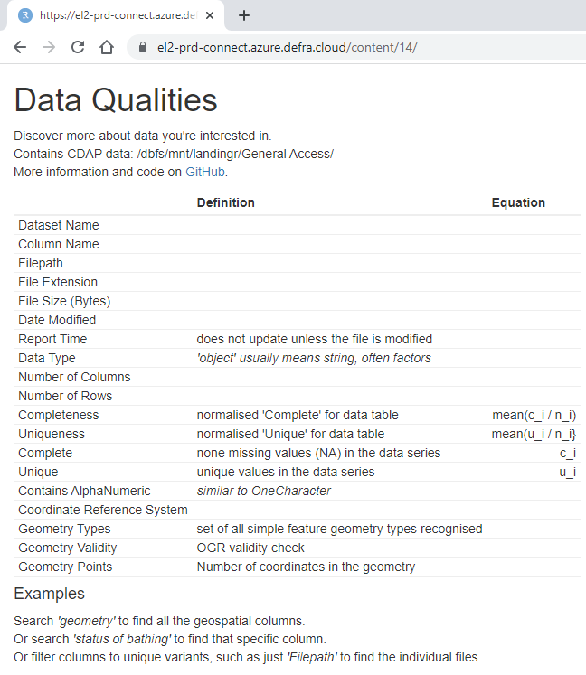
No promises of beauty!
Nor promises that it is explained well. But I will try, please suggest improvements!
The data catalogue exists for metadata, descriptions, and audit information, sorry I won’t have those metrics.
It works by crawling through CDAP data, reading known data types using pandas, and calculating metrics. Available on GitHub:
https://github.com/Defra-Data-Science-Centre-of-Excellence/MS2_DataQuality/

Slide 4
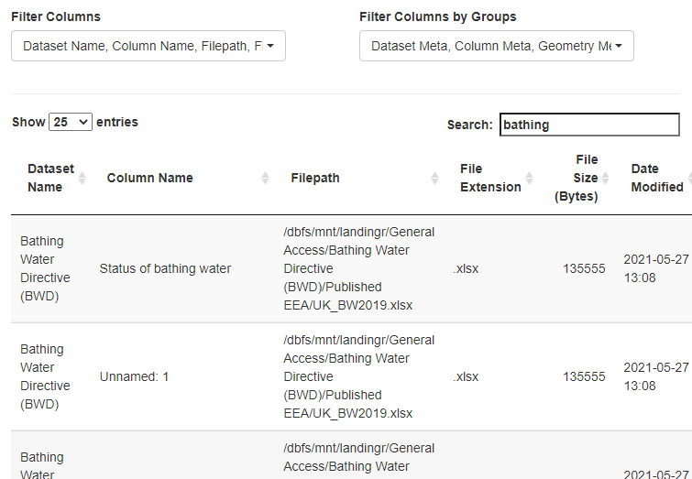
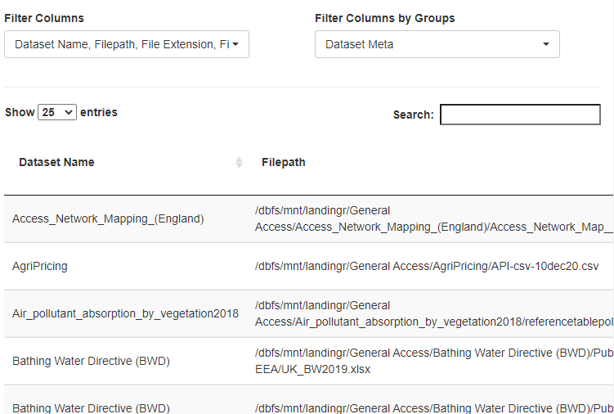
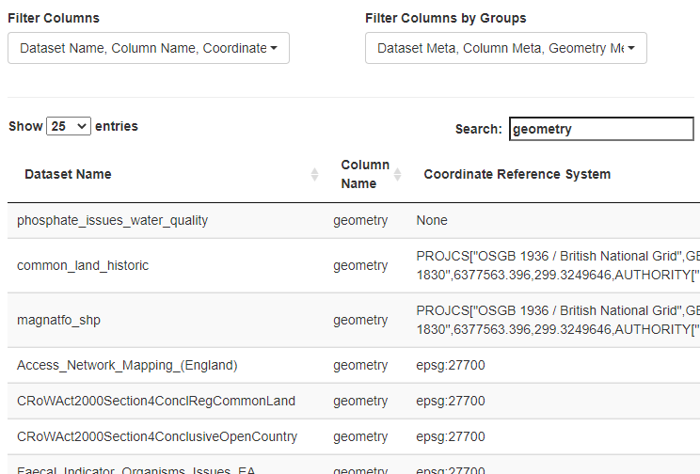
Filter or Search
Search
Filter Columns
*this also applies a unique to the table
Order
Combine a filter, search, and order by CRS to find geometries that don’t use British National Grid (they actually do!)

Slide 5
Access
Go to link: https://el2-prd-connect.azure.defra.cloud/content/14/
Login with Email and MS password
Hopefully it is that easy!
Any problems I can temporarily make it open access.

Slide 6
CDAP User Experience
Andrew West
2021-10-28 15:03

Slide 7
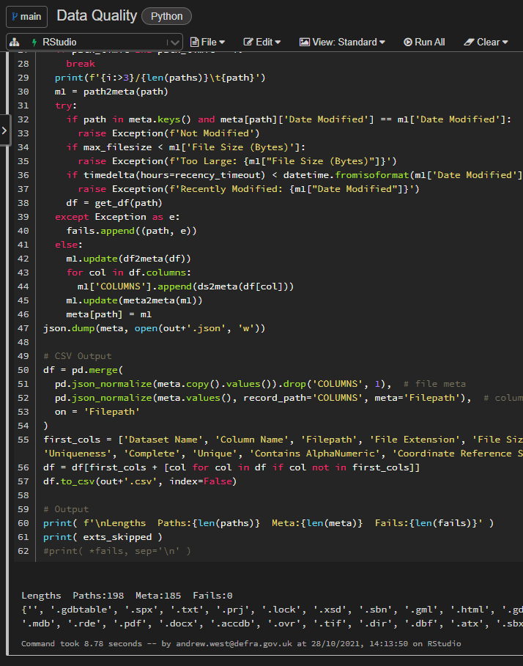
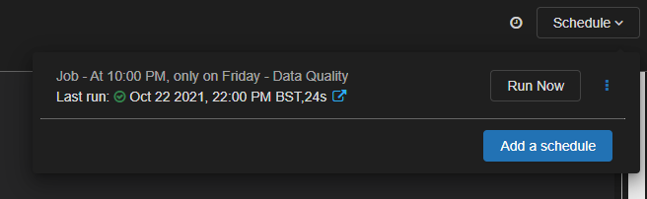
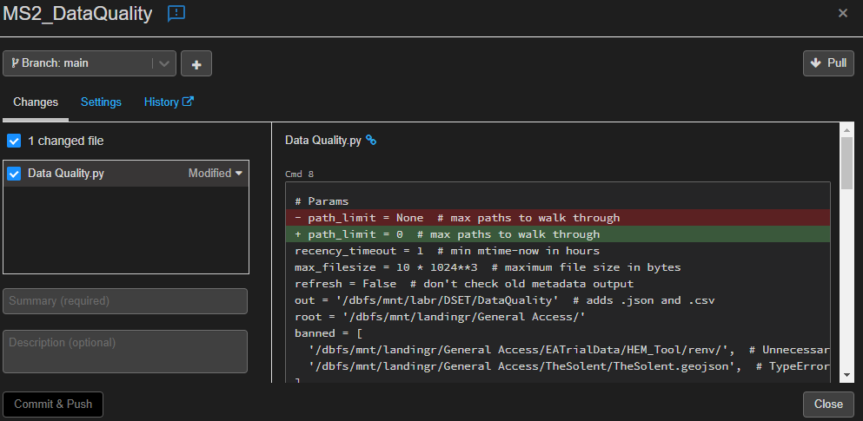
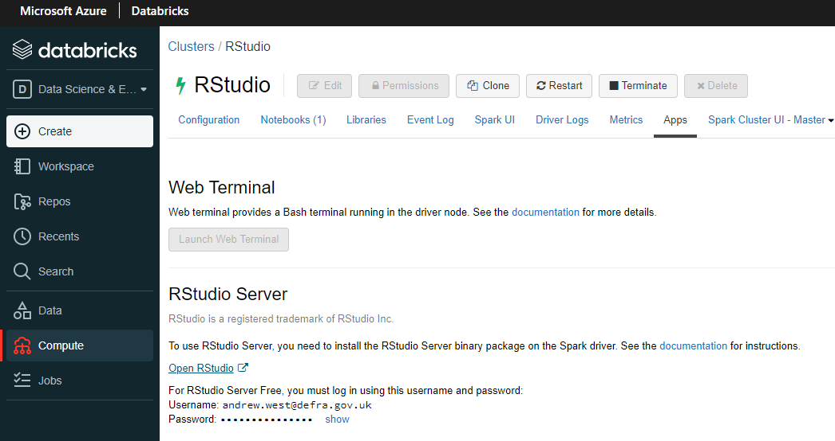
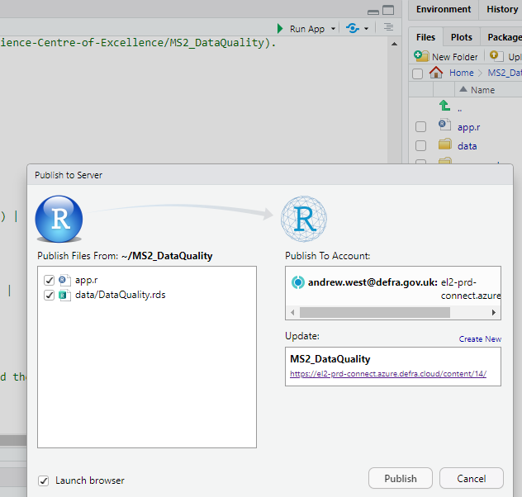
I have used
Workspaces
Notebooks
Jobs
Repos
RStudio Connect

Slide 8
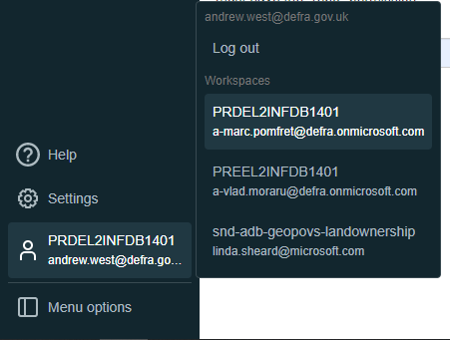
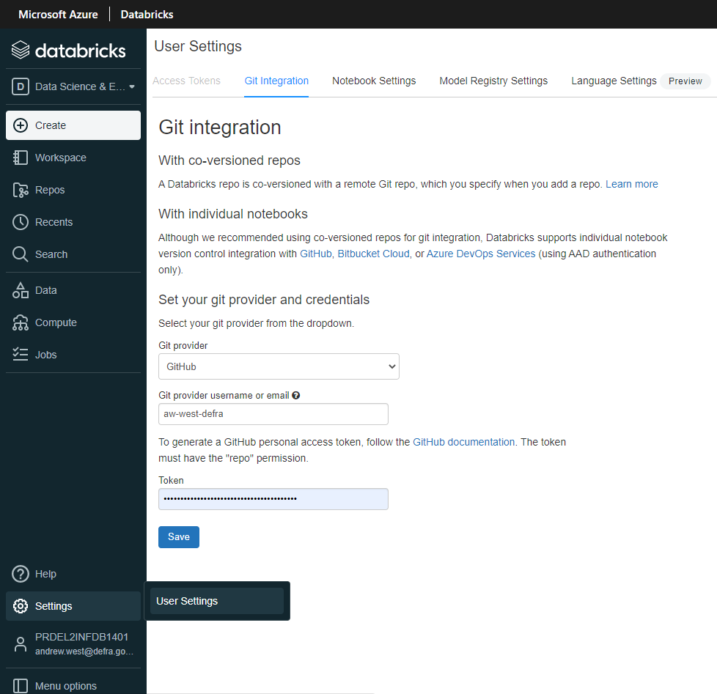

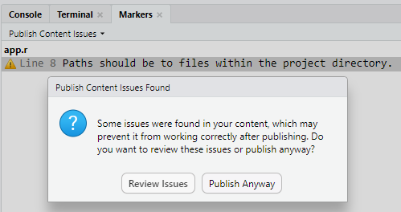
Just my experience
Workspaces I have a few, and switching is seamless.
Notebooks are good, just like iPython/Jupyter, but better!
Because Repos save these notebooks as plain Python/R so it can be run easily outside CDAP.
Repos are pretty easy to use.
Git integration is easy when you know how.
Jobs are great! I am currently running this
data qualities tool every week.
RStudio bad ☹
Terminal is very laggy. The file systems aren’t well linked in reverse. You have to publish to Connect, annoying for updating data.
But RStudio Connect itself is easy to use.

Slide 9
Questions
Andrew West
2021-10-28 15:03
https://el2-prd-connect.azure.defra.cloud/content/14/
https://github.com/Defra-Data-Science-Centre-of-Excellence/MS2_DataQuality/

